Slide 1
Turning Dreaming into Doing
-
A Life Manual for Nerds

Slide 2
Notes:
Llamas

Slide 3
Disclaimer:
I don’t have all the answers
This is my subjective opinion
Take what you can use and leave the rest
Your journey will be different from mine
Ask lots of questions
Don’t ask about Lego or cars unless you want a 4-hour talk…
Notes:
Disclaimer. I don’t have all the answers. This is my subjective opinion. Take what you can use and leave the rest.

Slide 4
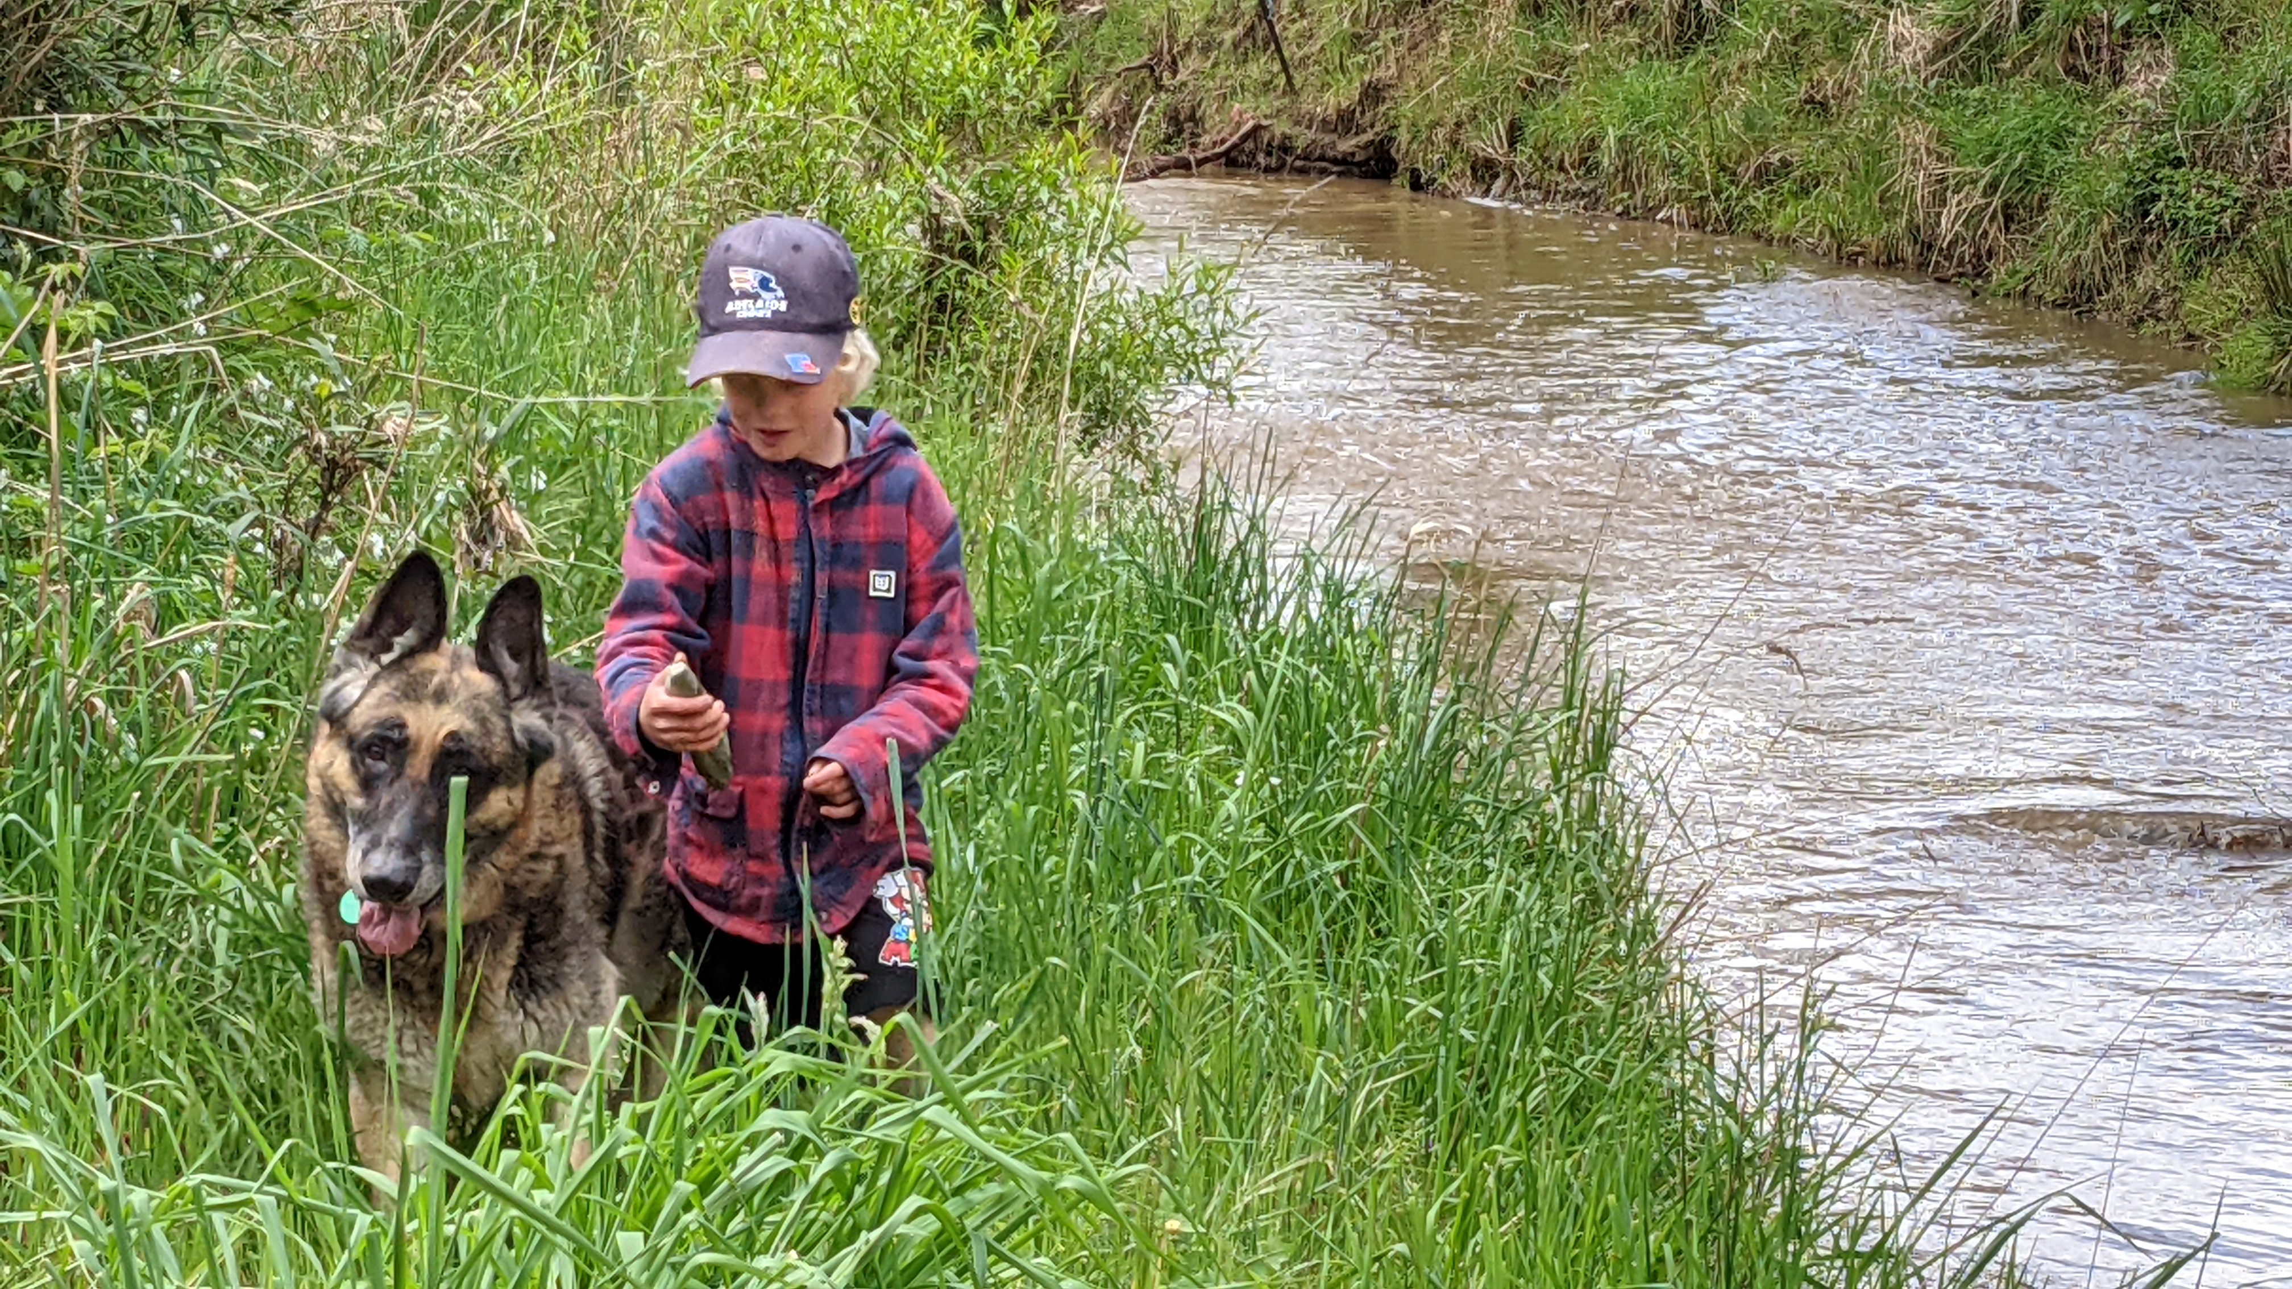
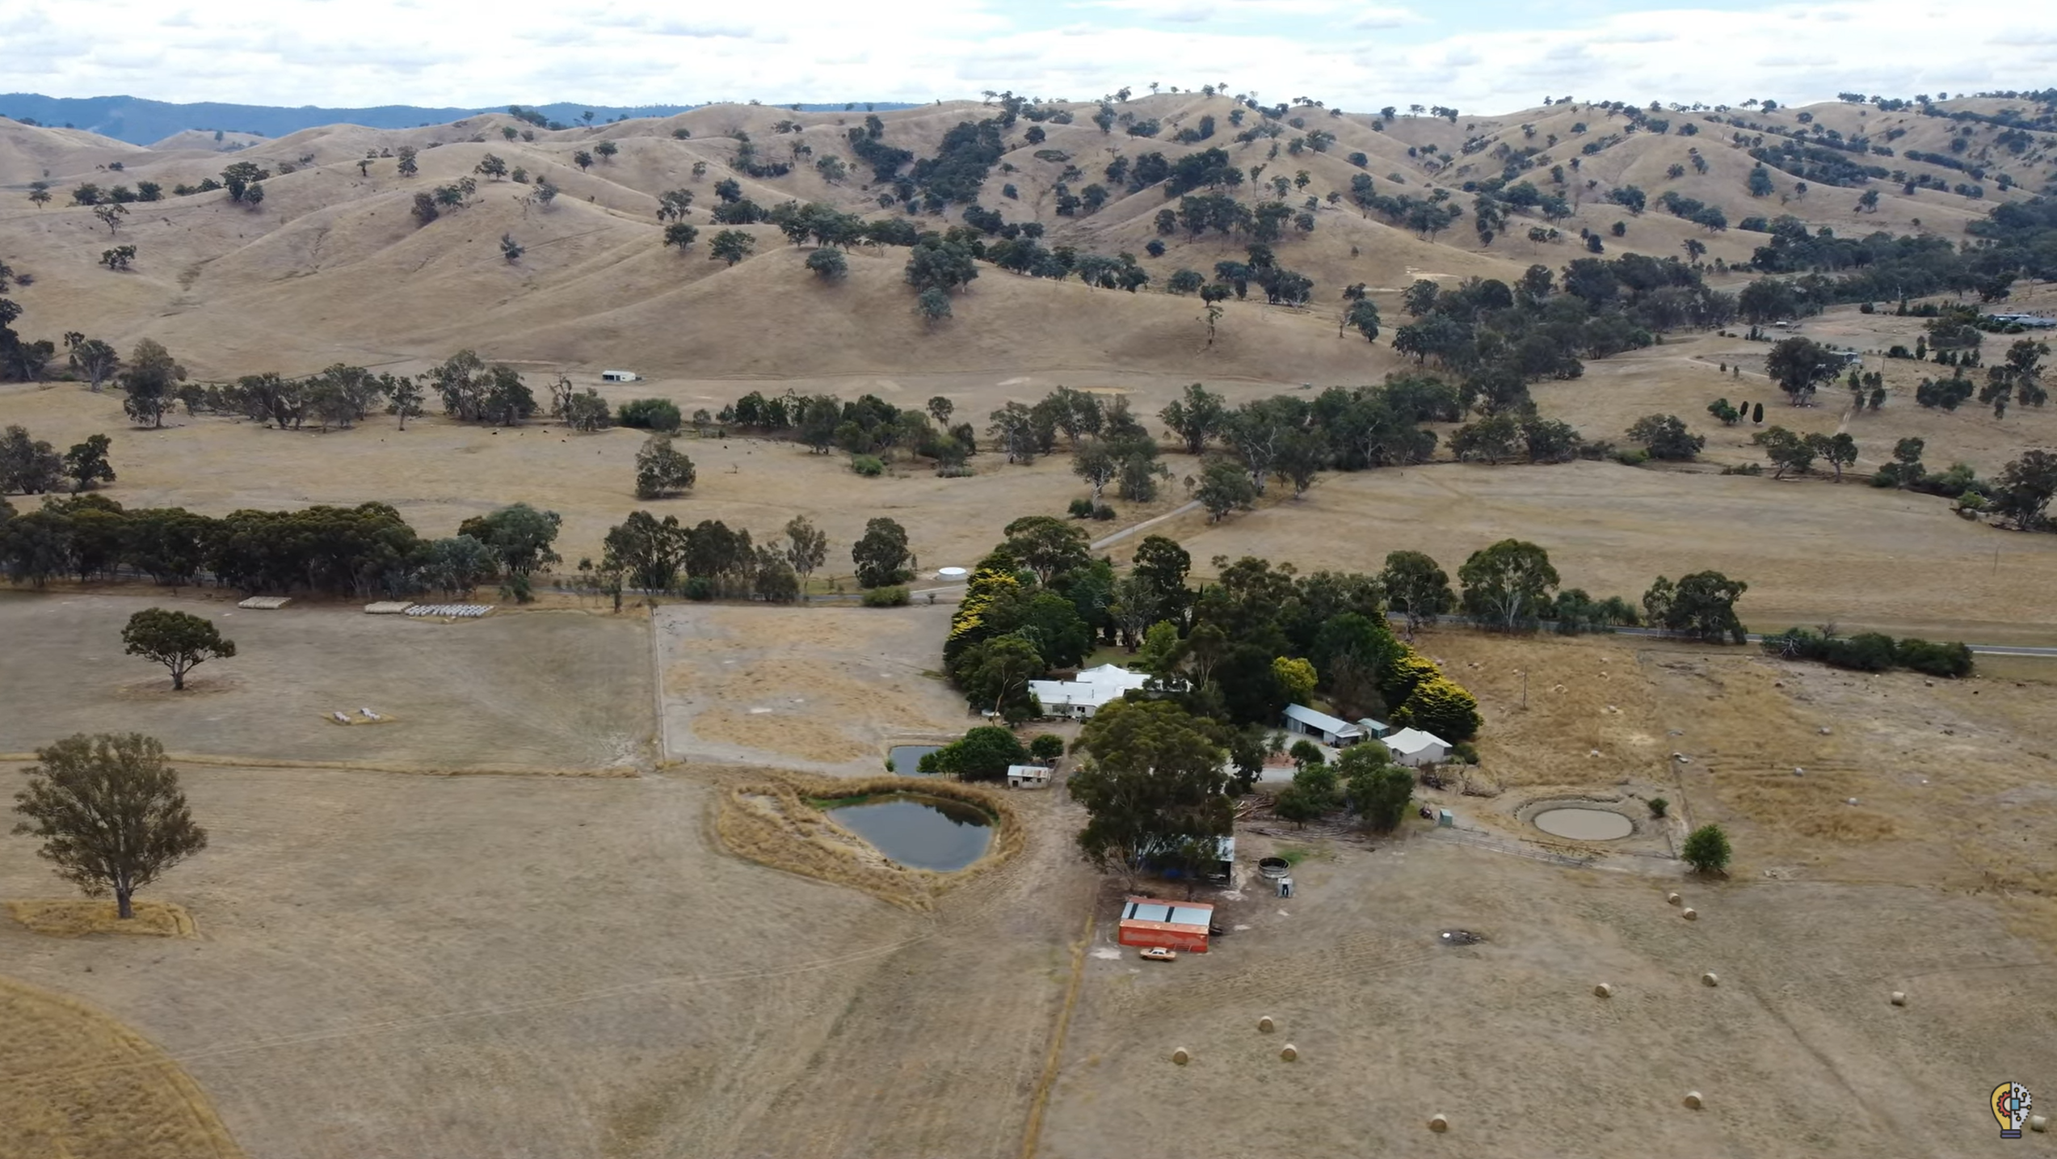
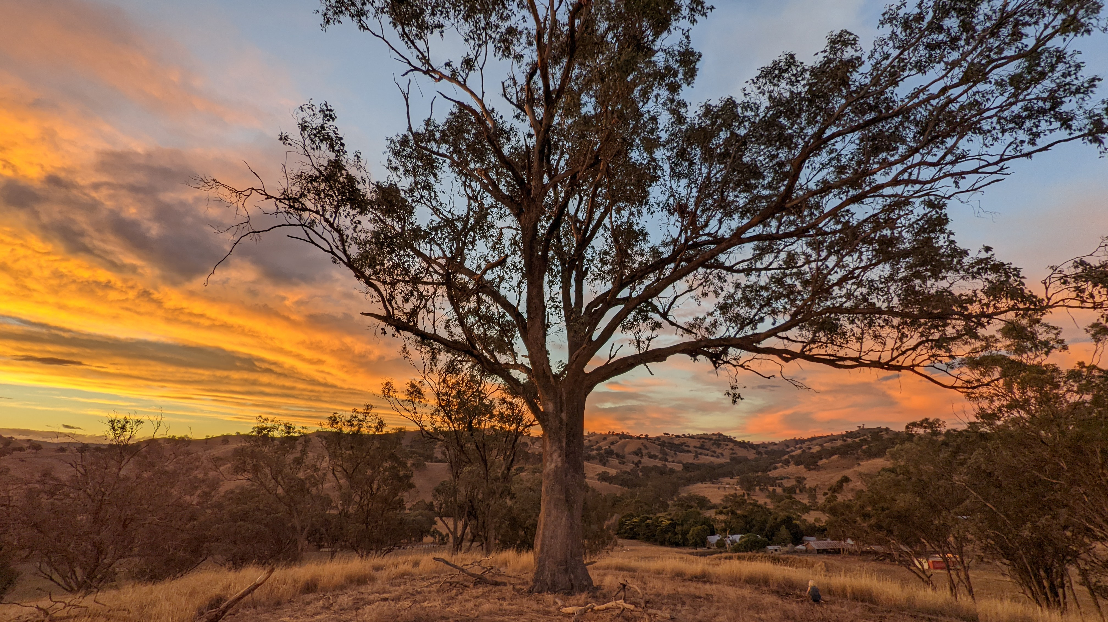
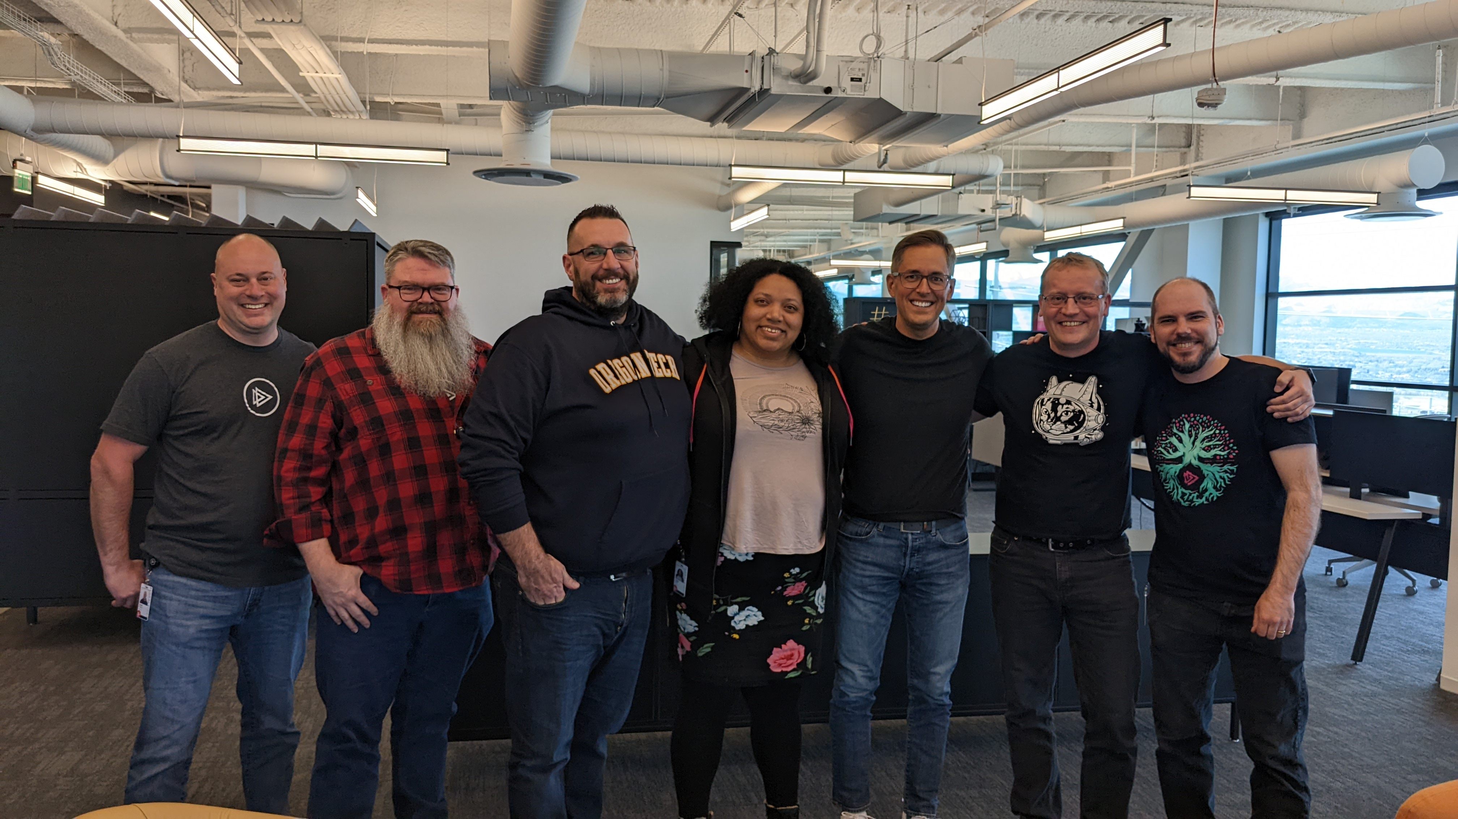
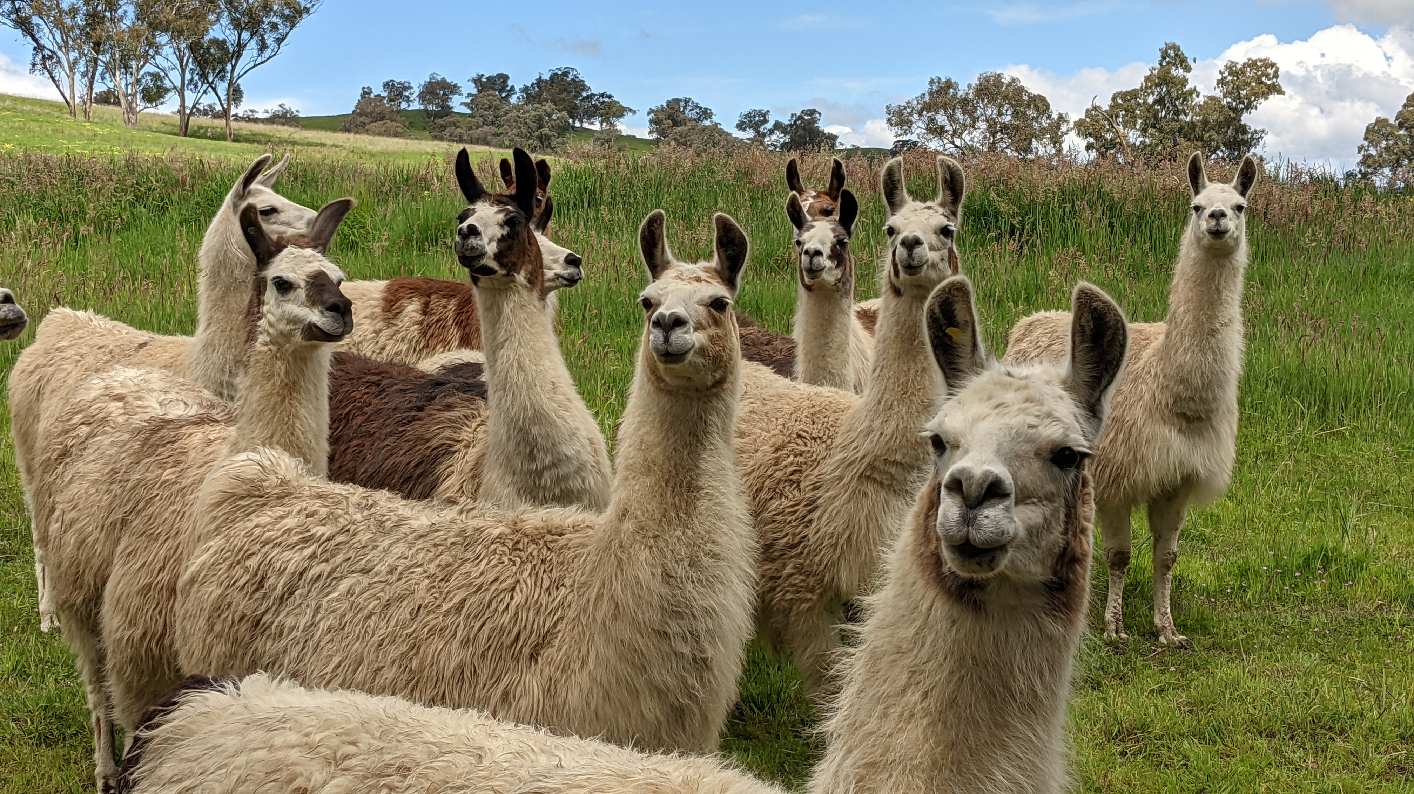
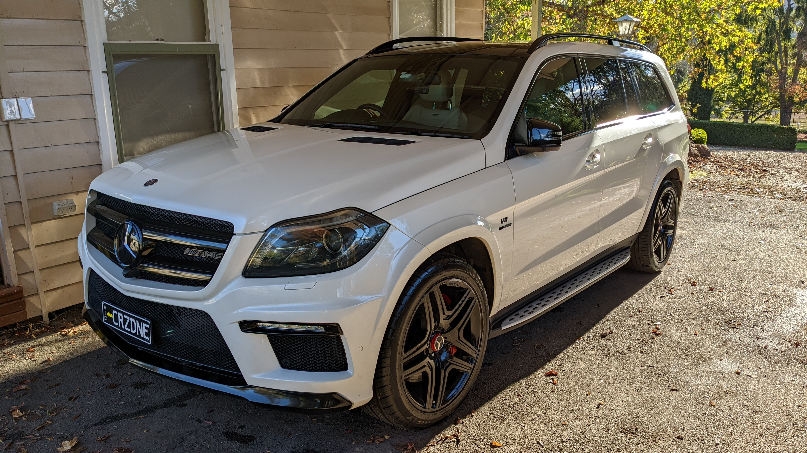
Notes:
Where am I at today?
Farm
Family
Great job (freebies at the end)
YouTube channel
Writing a book (2 to give away)
Cars
Travelling, and be here with you lovely people
And yes, there are llamas
And lego
This didn’t happen by accident.

Slide 5
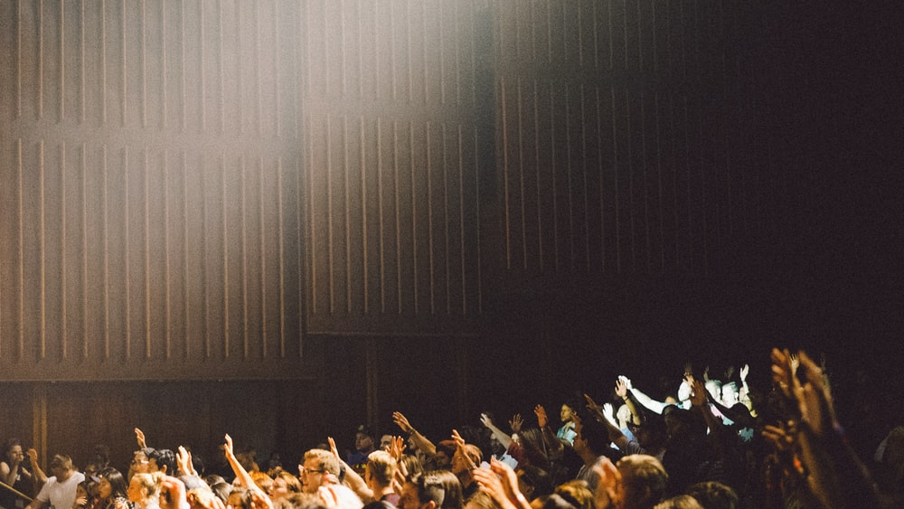
Are you genuinely happy?
Have you set goals?
Is the grass greener?
Notes:
Who here is genuinely happy with their current achievements, circumstances etc.?
Who has goals to achieve and changes to make?
Do you see others and wonder how they “seem to do it all”?

Slide 6
Have you got dreams?
No, bigger ones!
Notes:
Who has dreams of things to do, places to go, people to visit? Who wants to share?
Ask for bigger dreams. Even bigger!
How do you turn those dreams into doing?
I am not going to tell you what to do.
It is your journey. I can give you some tips of what has helped me though.

Slide 7
Want more time?
Notes:
Who doesn’t have enough time?

Slide 8
Notes:
Who has a Netflix account? What is the latest show you watched? How many episodes? Seasons?
I don’t, which means I don’t get a lot of pop culture references. I often can’t join in conversations. But it is a choice.
You might ask, how do I then relax? I watch a movie. I build Lego. I do something finite.
Oh, and did you know Netflix basic tier now has ads?

Slide 9
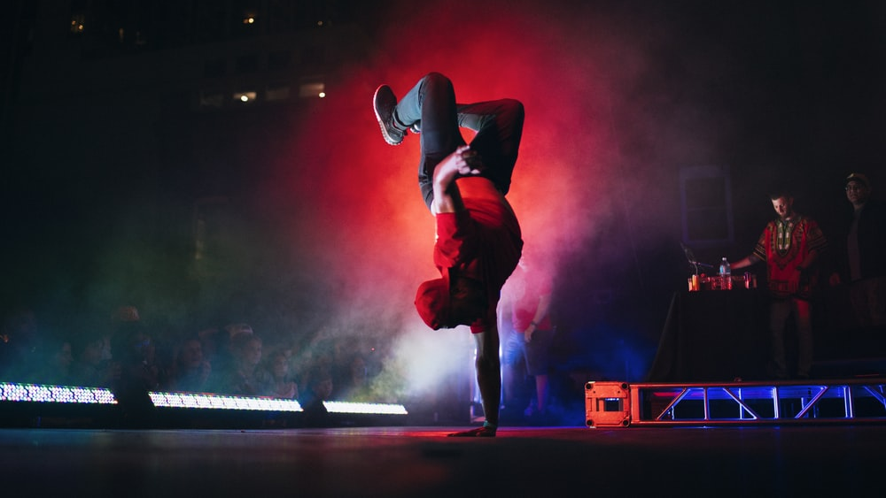
Be intentional
Notes:
Be intentional.
What do you want to be accountable for? Take ownership.
This is how you get the time you need for many things. Intentionally choosing things.
Ask someone if they will join my event.
- Attending an event, saying “I’ll try and make it”

Slide 10
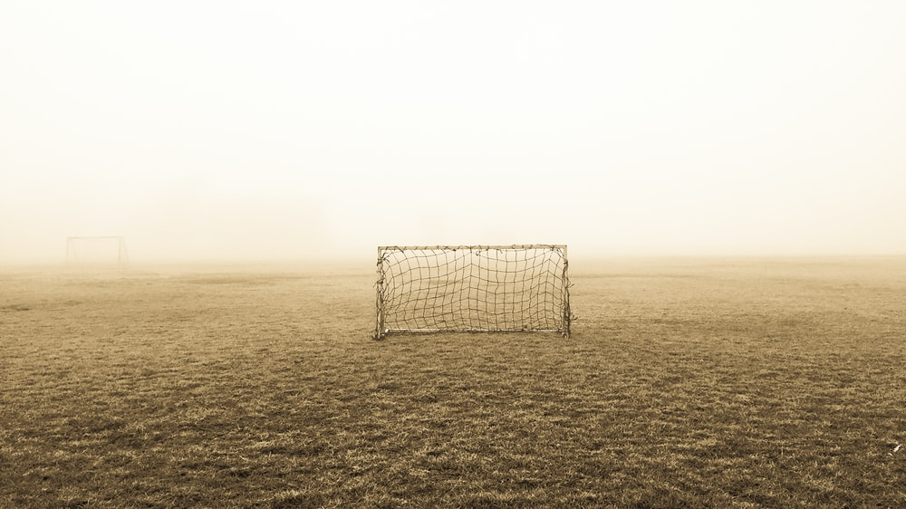
Notes:
Have goals.
No, not that kind of goals.

Slide 11
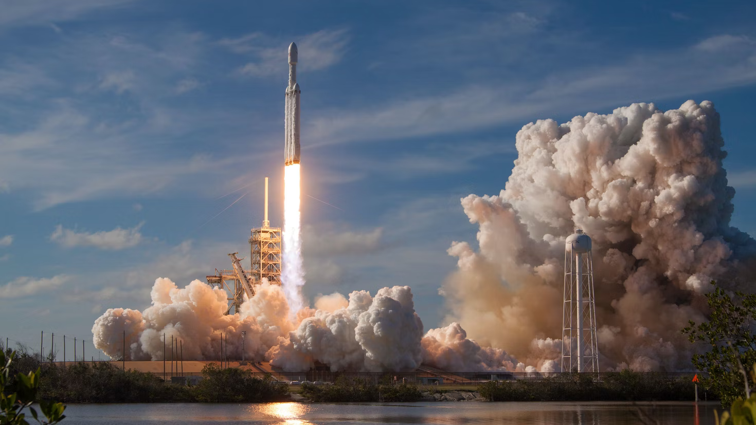
Notes:
Set ambitious goals.
- AMG.
- YouTube channel subs.

Slide 12
Notes:
Goal – AMG
Might not be a car for you, but make it something important.

Slide 13
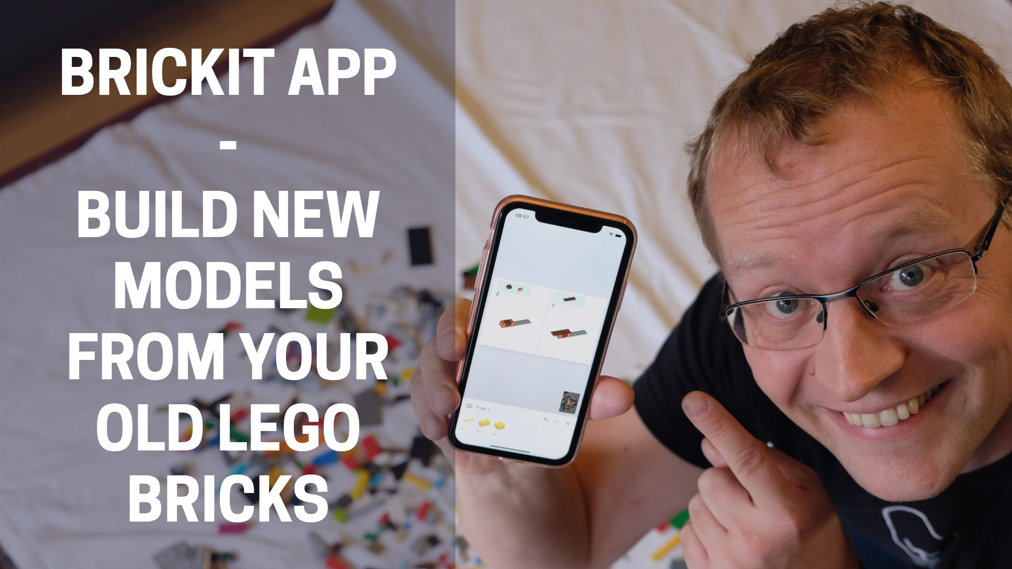
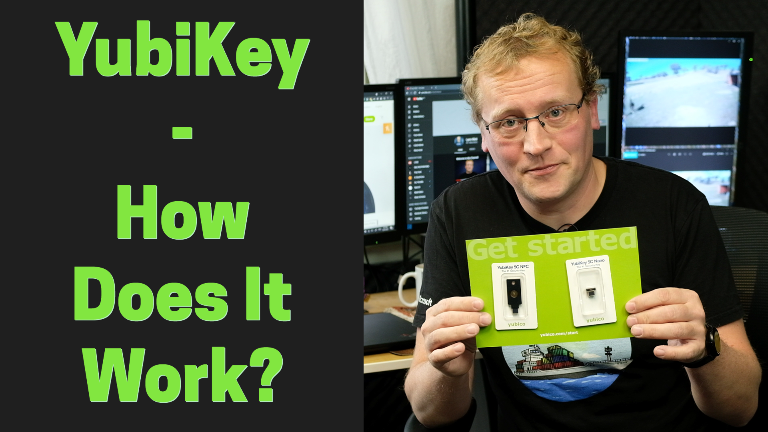
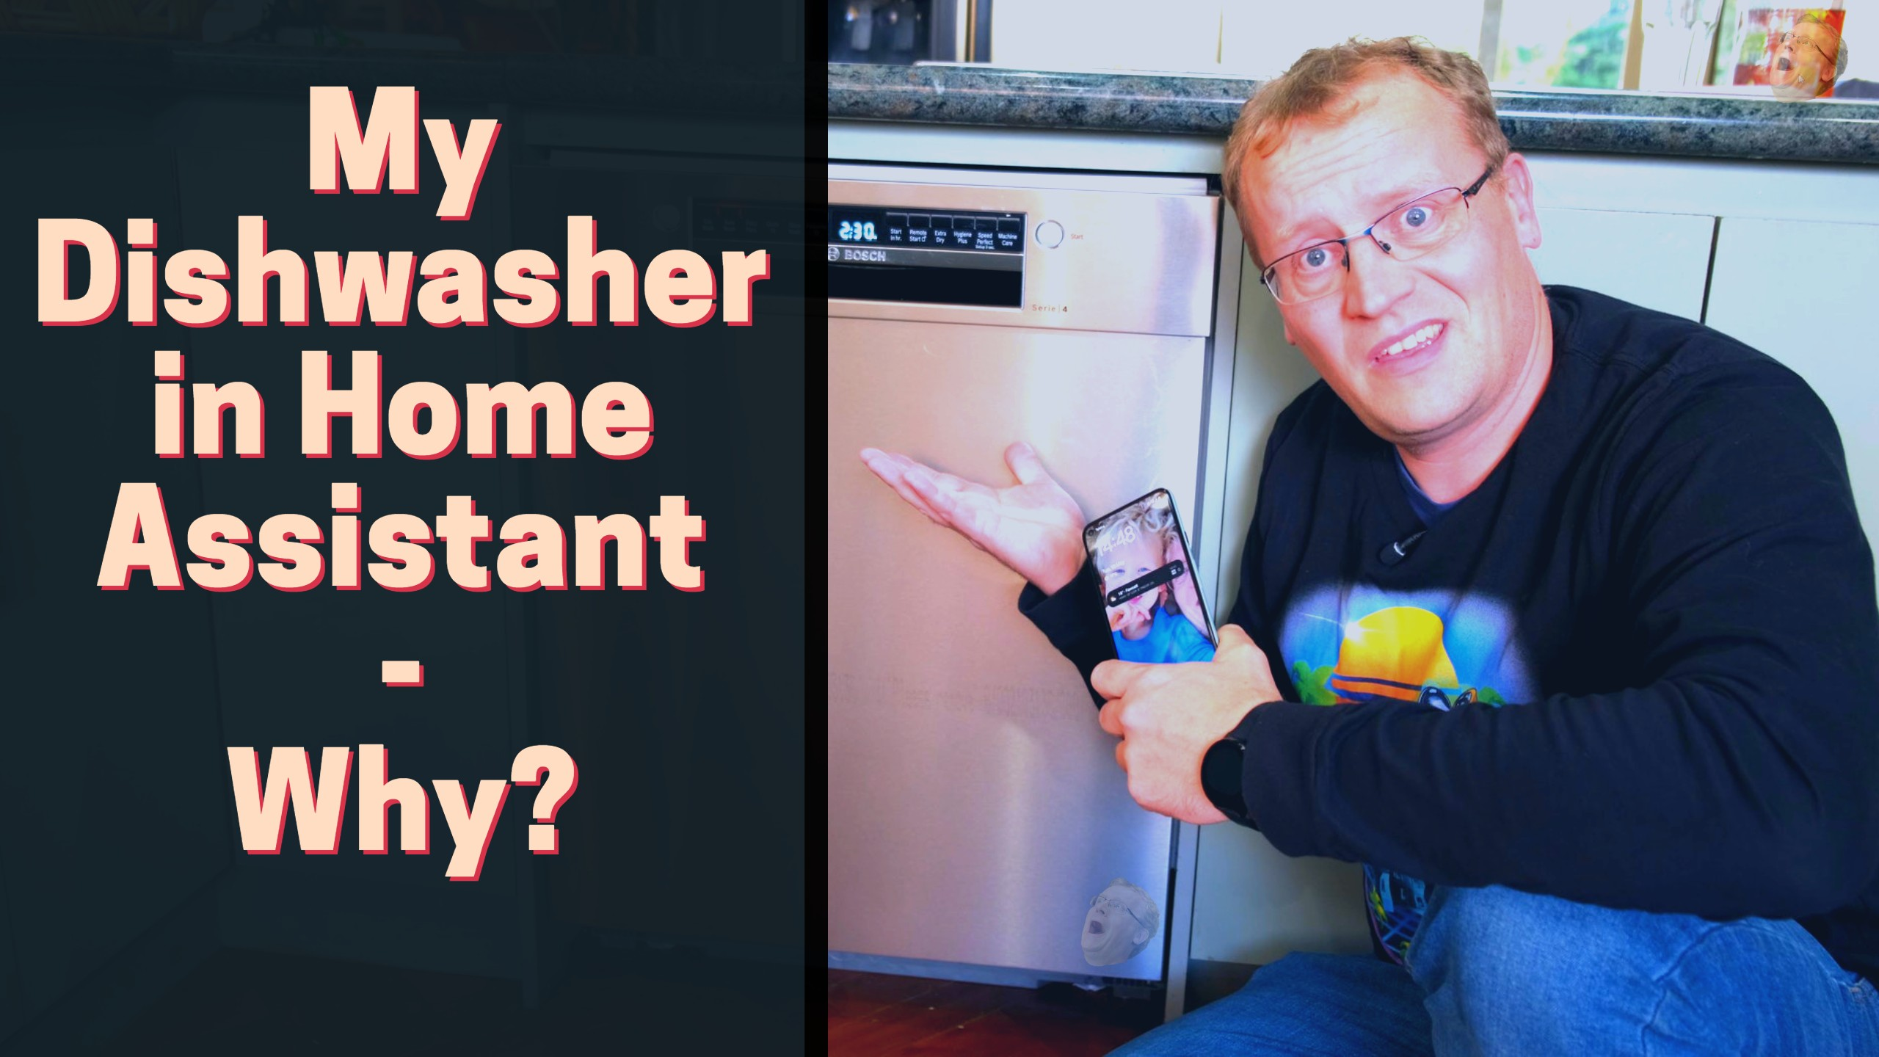
Notes:
YouTube subscriber numbers
Got to 1000 subs 3 months early
Want to get to 3000 this year, it was 5000

Slide 14
What are your goals?
Notes:
Anyone wants to share goals?
I’ll go first. 3000 subscribers by end of 2022.
Pay off my mortgage by 2026.
Finish writing my book by March 2023

Slide 15
Notes:
Solving more and more problems until you succeed.

Slide 16
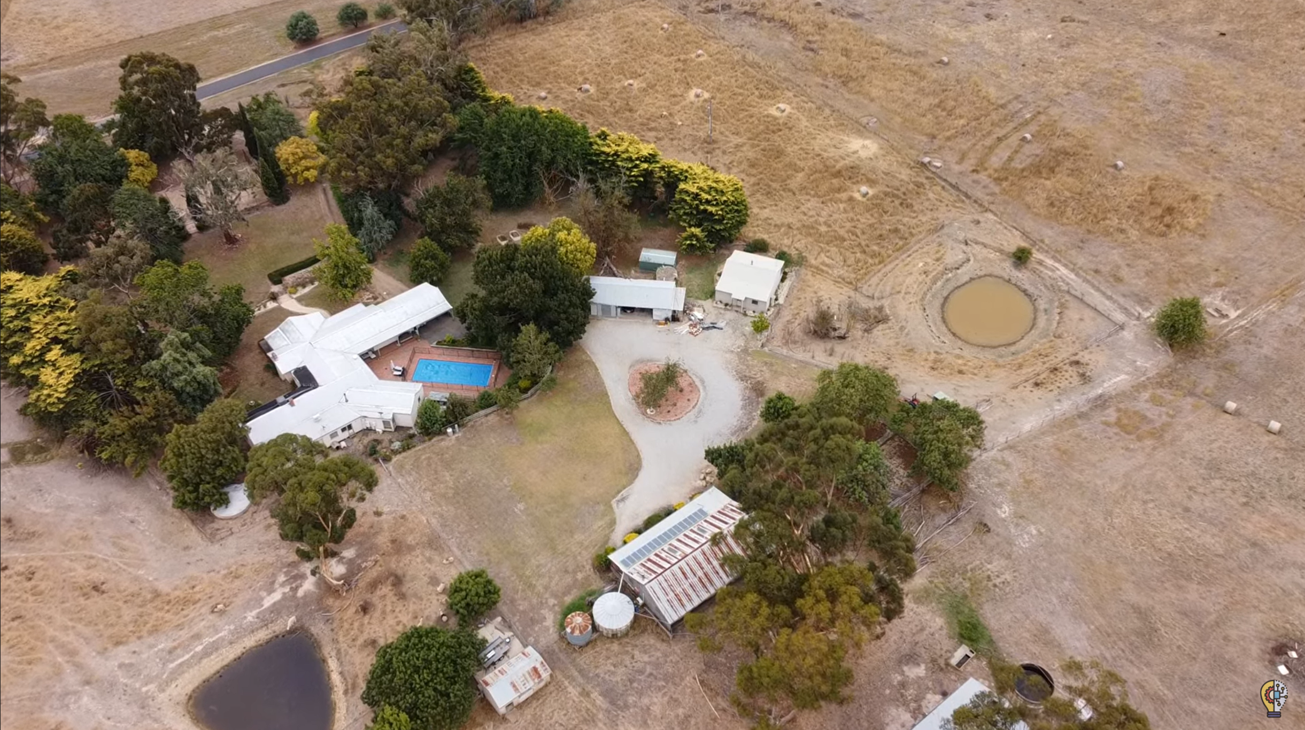
Notes:
How I got the farm was by solving more problems than most are willing to.

Slide 17
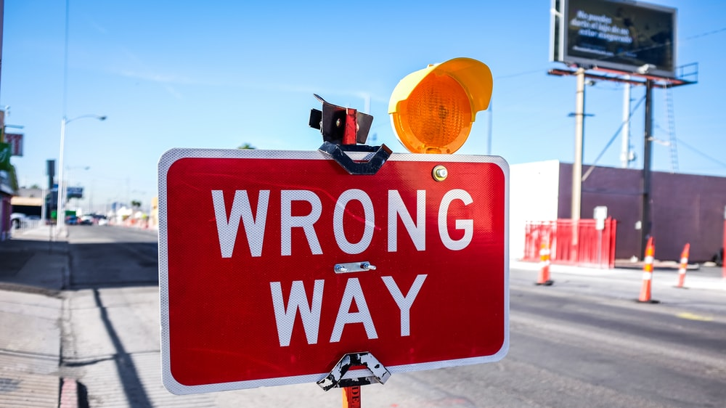
Own your mistakes
Notes:
Own your mistakes.
Pluralsight quantum course.

Slide 18
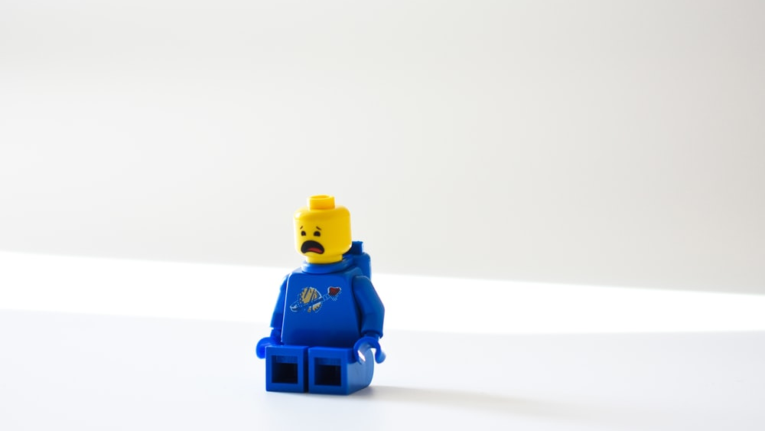
Adversity and “the birds”
Notes:
Reverse the energy. This is a hard one.
When Shaun told me I’m a crap dev.
People will try and project their insecurity on you. It isn’t their journey.

Slide 19
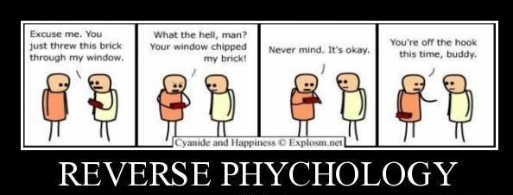
Notes:
Reverse the energy in your head.

Slide 20
Get a mentor...
or two
Notes:
Find a mentor.
Can be someone younger or older.
It is someone that has your interest at the forefront. Give you new perspectives.

Slide 21
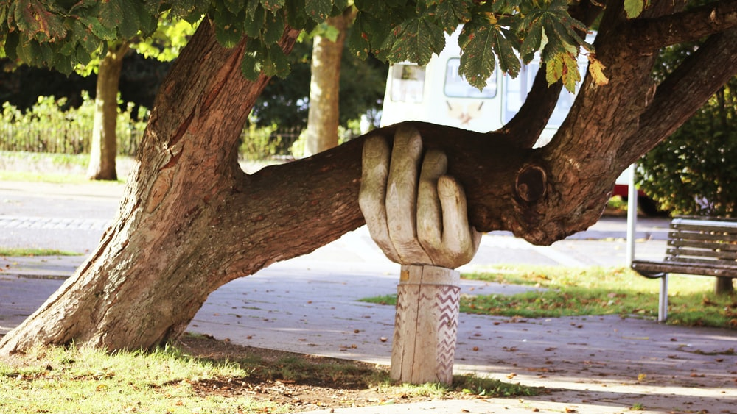
Friends
Notes:
Lose “friends”. Remove those from your circles that don’t support your journey.
People that constantly try to stop you.
Family is often the hardest to manage.

Slide 22
Notes:
So, this talk is about turning dreaming into doing. Turn idea into reality. How?
Plan
Iterative
Hard work
Action, and actually doing something

Slide 23
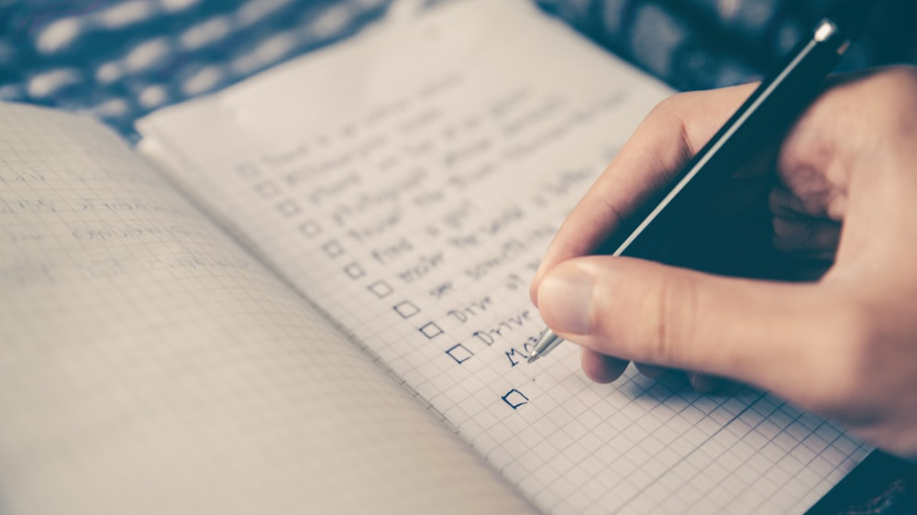
Plan
Notes:
Plan
We planned on buying a VW Toorak V10

Slide 24
Notes:
Re-evaluate
Turned out the V10 was complicated and not exactly what we wanted.
Went through Audi Q7 V12, then BMW X7, then ended with the GL63.

Slide 25
Hard work
Notes:
Hard work. Find enjoyment in the hard work.
I don’t do an 8 hour day. I sometimes start at 6am, go until 10pm with a break here and there. Some days I do much less.

Slide 26
Notes:
Take action! Nothing happens without action.
Don’t wait for others to do it for you. Get into it.

Slide 27
Notes:
What can you do today?
Get that blog article out
Call an old colleague
Sign up for a user group talk
Cancel a subscription
Make a new friend.
Do today what others won’t so tomorrow you can do what others can’t

Slide 28
Right now:
Change one thing
Notes:
Leave you with this
- Change one thing today that either sets a goal or gets you closer to a goal.

Slide 29
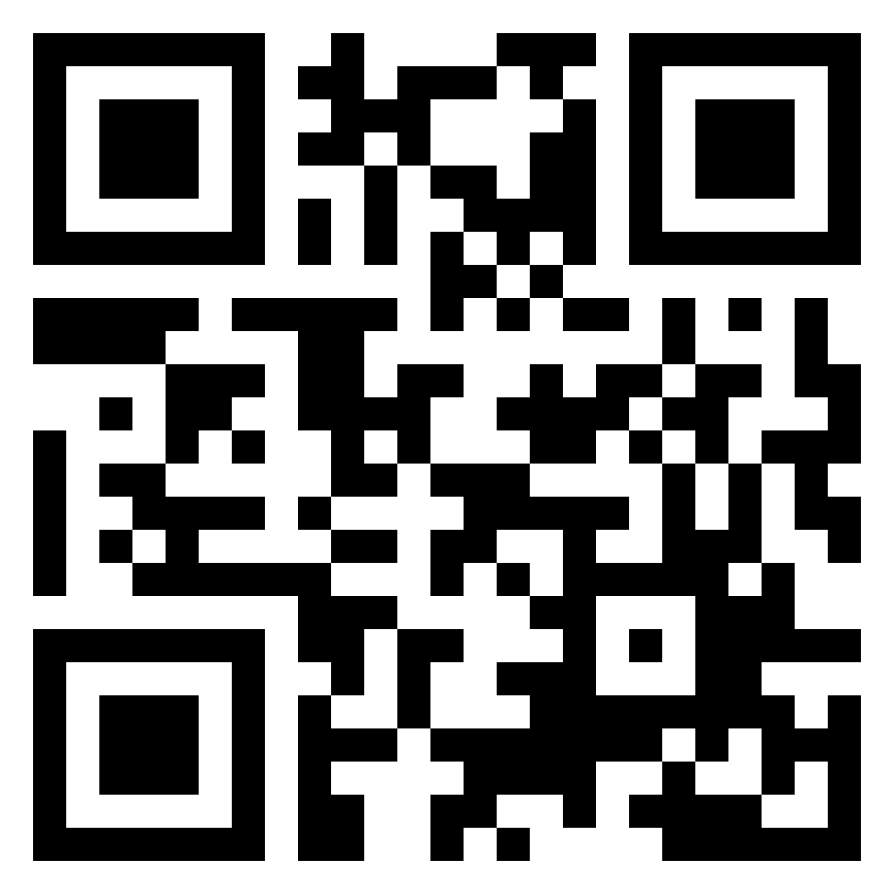
https://www.manning.com/books/microsoft-azure-in-action
ctwyowsyd22
Notes:
Give two copies away.
35% off with code.

Slide 30
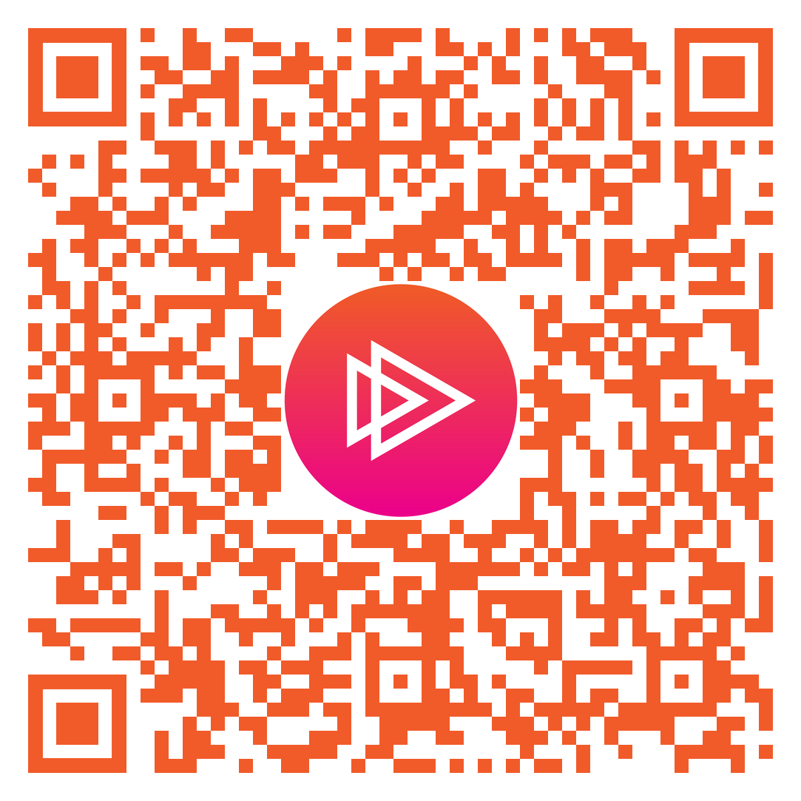
Free 30-day full access to Pluralsight
Notes:
Questions and freebie

